Slide 1
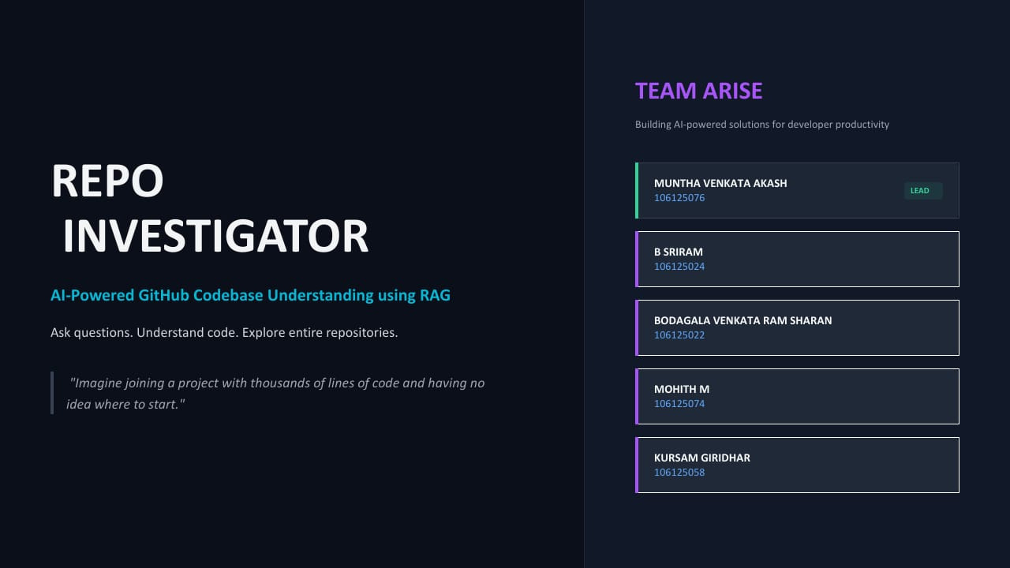

Slide 2
FROM GITHUB CODE TO
INTELLIGENT ANSWERS
PROBLEM
Developers struggle to understand unfamiliar repositories because code and logic are scattered across multiple files.
SOLUTION
Repo Investigator uses AI-powered RAG to understand repositories, answer cross-file questions, and provide exact code citations.
WHY MONGODB ATLAS
Stores code chunks, embeddings, and metadata together, enabling hybrid retrieval and evidence-based answers.
REPOSITORY INGESTION
QUESTION ANSWERING
1 GITHUB REPOSITORY
Fetch files
2 PROCESS + CHUNK
Code + metadata
3 EMBEDDINGS
Gemini vectors
4 MONGODB ATLAS
Store evidence
5 USER QUESTION
Natural language
6 RETRIEVAL
Vector + keyword
7 RESULT FUSION
RRF rankings
8 GEMINI ANSWER
Grounded explanation
9 CITATIONS
Files + lines
GITHUB REPO LINK: https://github.com/kursamgiridhar-web/rag_github_tool
DEPLOYED WEBSITE LINK: https://frontend-ashen-tau-34.vercel.app

Slide 3
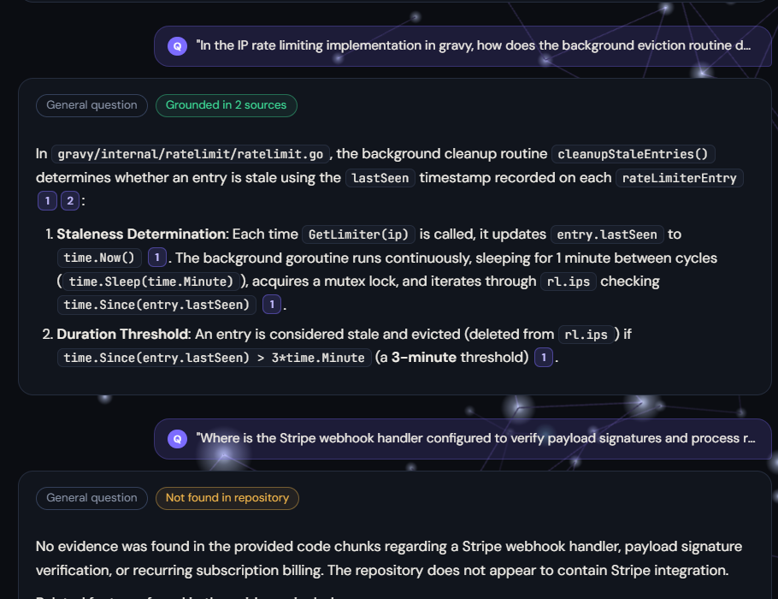
DEMO FLOW
From repository import to evidence-backed answers
01 IMPORT REPOSITORY
Import a GitHub repository.
02 INDEX THE CODE
Chunk files, generate embeddings, and store them in MongoDB Atlas.
03 ASK A CROSS-FILE QUESTION
Ask a question that requires understanding across multiple files.
04 SHOW EVIDENCE
Show the generated answer and exact source citations.
RAG Pipeline Optimization & Metric Improvements
Retrieval: Increased chunk limit from 10 to 15 (+50%), capped chunks per file at 2 for cross-file diversity, and expanded keyword extraction from 12 to 16 identifiers.
Generation: Set temperature to 0.0 for deterministic grounding, enforced schema-completeness directives, and added anti-extrapolation guardrails against unsupported SDK assumptions.
Results: Improved schema correctness from 20% to 90%, achieving 91% Context Recall, 93% Faithfulness, and 86% Answer Correctness across 11 edge-case categories.
05 TEST THE LIMITS
Try an ambiguous or unanswerable question and demonstrate the response.

Slide 4
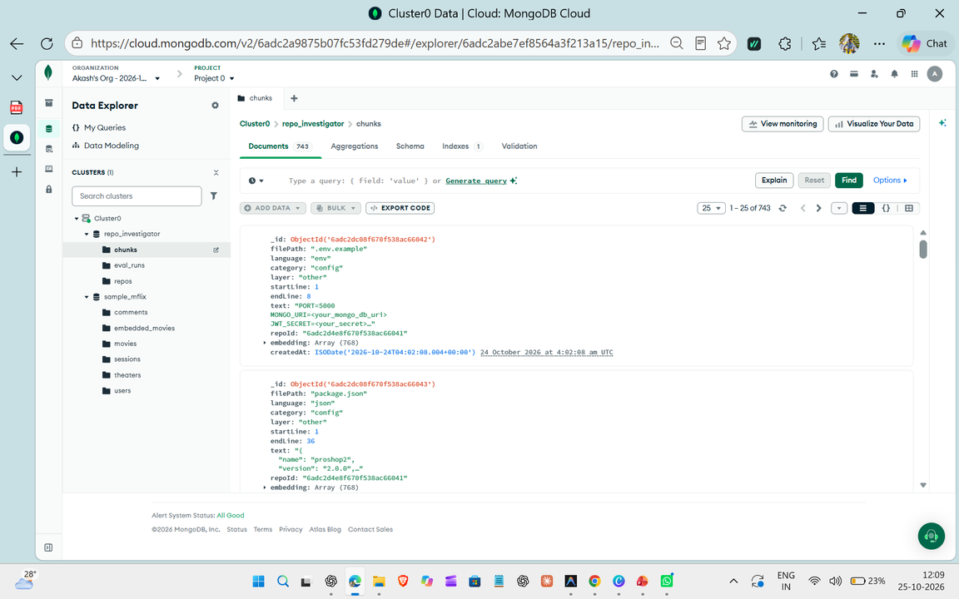
HOW MONGODB POWERS
OUR RAG SYSTEM
WHAT ATLAS STORES
Original Code
Chunks retained as evidence
Embeddings
Vector representations for semantic search
Metadata
Repository, file paths and line ranges
1. Repos Collection: Stores repository-level metadata, including GitHub URL, owner, repository name, branch, processing status, file count, chunk count, and error information. It tracks the repository's indexing and processing progress.
2. Chunks Collection: Stores code divided into smaller, searchable chunks, along with repository references, file paths, line ranges, and Gemini-generated embedding vectors. These chunks enable Vector Search, Atlas Search, cross-file retrieval, and source-level citations for evidence-grounded answers.
GITHUB CODE
CHUNKS + META
+ EMBEDDINGS
MONGODB
ATLAS
VECTOR + KEYWORD
SEARCH
RRF
GEMINI

Slide 5
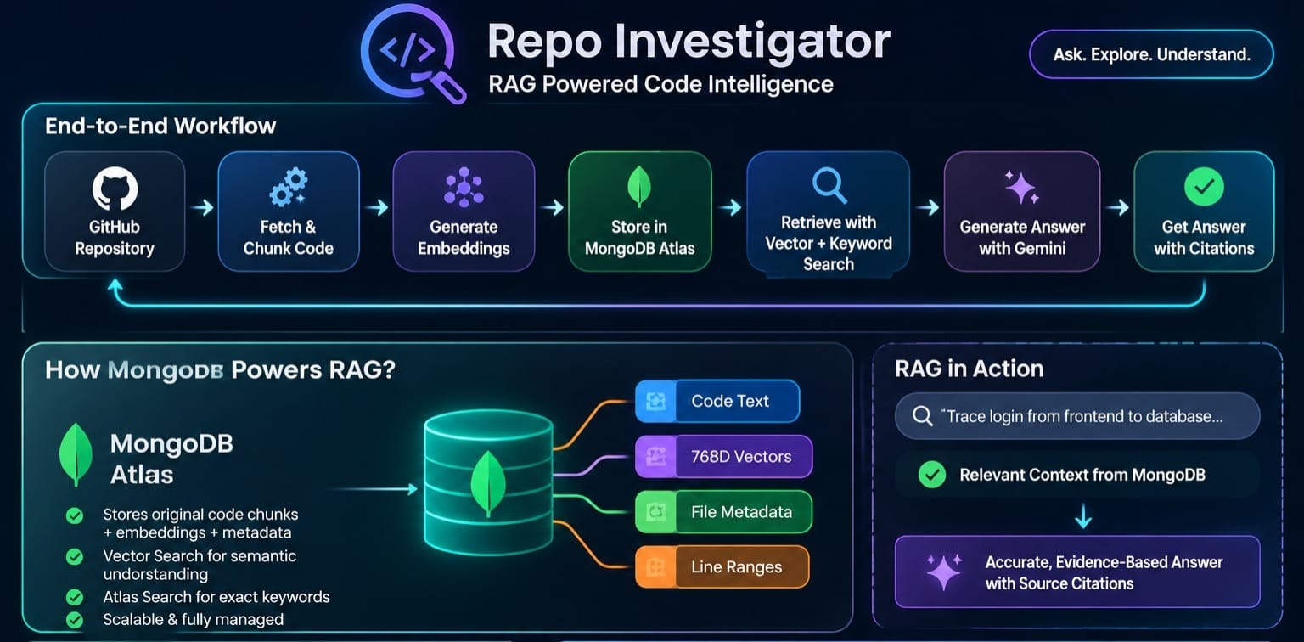
BEYOND SIMPLE CODE SEARCH
Repository
Exploration
Evidence-Based
Answers
Source Citations
Cross-File
Reasoning
MongoDB Atlas & Hybrid Search: MongoDB Atlas serves as our unified storage and retrieval layer, storing code chunks, Gemini-generated embedding vectors, repository metadata, file paths, and line ranges. MongoDB Atlas Vector Search enables semantic retrieval by comparing query embeddings with stored code embeddings, while Atlas Search supports lexical keyword matching for exact identifiers, function names, and symbols. We combine both retrieval methods using Reciprocal Rank Fusion (RRF) to improve relevant evidence retrieval across multiple files. Repository metadata helps scope retrieval, while source paths and line ranges support traceable citations. The retrieved evidence is passed to Gemini to generate grounded answers, making MongoDB Atlas central to our cross-file code understanding and evidence-based RAG architecture.

Slide 6
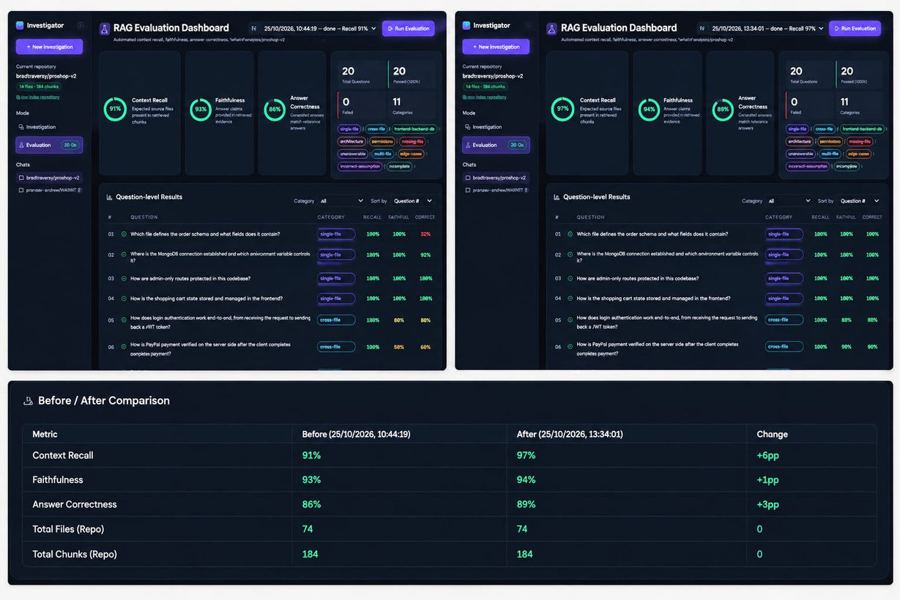
HOW DO WE MEASURE RAG QUALITY?
20 TOTAL QUESTIONS • 20 PASSED • 11 EVALUATION CATEGORIES
RAG Pipeline Optimization & Metric Improvements
Retrieval: Increased chunk limit from 10 to 15 (+50%), capped chunks per file at 2 for cross-file diversity, and expanded keyword extraction from 12 to 16 identifiers.
Generation: Set temperature to 0.0 for deterministic grounding, enforced schema-completeness directives, and added anti-extrapolation guardrails against unsupported SDK assumptions.
Results: Improved schema correctness from 20% to 90%, achieving 91% Context Recall, 93% Faithfulness, and 86% Answer Correctness across 11 edge-case categories.
single-file • cross-file • frontend–backend–database • architecture • ambiguous • missing-file • unanswerable • multi-file reasoning • edge cases • incorrect assumptions • incomplete

Slide 7
THANK YOU
TEAM NO:1
ARISE

